Slide 2

The Deutsch Jozsa Algorithm
Harshit Gupta
IBM Qiskit Advocate
BTech. COE, NSUT
Notes:
Today our lecture would comprise of one of the first quantum algorithms to show quantum advantage
We will have a small refresher over algorithmic complexity and then dive into the deutsch jozsa problem
After that we'll look at the classical solution and then get into the quantum counterpart
Let's get started

Slide 3
Algorithmic Complexity
How ‘good’ is any algorithm
The metric we take is the running time
How is running time of an algorithm affected if the input size changes?
Notes:
Our first topic is gonna be algorithmic complexity
Hint a dsa reference
It is essentially a way to evaluate how good an algorithm is with respect to some metric
The metric which we are exploring right now is running time, we can also have memory or the number of processors required (if it's a parallel algo)
Our goal is to somehow capture this time in terms of the input size which is given to our algorithm

Slide 4

Big - O Notation
The worst case number of comparisons or computations needed in any algorithm
Helps us estimate how the algorithm behaves in tough spots!
Example - Searching
Say we have a list of N elements - [ 1, 2, -3, 0, …, x] and we want to search for an element key in this list.
Our algorithm will be simple, go to each element, compare with the key, if it’s equal stop.
If it’s not continue till the list is there.
What will be the worst case?
Notes:
Big O notation is a great way to model that
It's the go to method for analysing how an algorithm will perform given a particular input size
But more specifically it targets the worst possible scenario of the input. That's because if an algorithm can handle tough spots, easy ones would be a cake walk
To illustrate this, let's see a very simple algorithm that is linear search
Simple read the slides

Slide 5

Big - O Notation
The worst will be that we are at the end of the list and the element is still not there.
This means we needed N comparisons for our searching algorithm in the worst case
This implies a running time of for our linear search algorithm.
Pretty easy right!
Notes:
For this simple algorithm, the worst case in term of number of comparisons would be when we can't find the element and have to search the whole list
This means we'll need comparisons or operations proportional to the size of the input list
This amounts to a running time of Big O(N) for our algorithm where N is the input size of list

Slide 6
The Deutsch - Jozsa Problem
Is a function balanced or constant, for all its possible inputs?
Notes:
With that knowledge let's look at the Deutsch josza problem
I hope most of you know functions, it's just a mapping from some input to an output where the same input can't have 2 distinct outputs
The problem is identifying whether a function is balanced or not

Slide 7

Problem Setup
We have a function which takes a binary variable x as its input.
x may contain any number of bits - 1, 2, 3, 4, …, n
only produces the outputs as 0 or 1.
x | f(x)
00 | 0
01 | 0
10 | 1
11 | 1
EXAMPLE
Balanced function!
What…
Notes:
In our problem, the function is defined as the following
It will be a function which would take in a binary string of n bits, as input and output a 0 or 1
The input bit size can be any positive integer and for an example you can see the given table -
Explain it
I say that this is a balanced function, but what do we mean by this?

Slide 8
Problem
We just saw how looks like.
The problem is - can we figure out if it is constant or balanced?
CONSTANT BALANCED
For all x only produces the outputs as 0 or 1 Produces 0 for half the inputs and 1 for others
Notes:
We saw the structure for f(x) and the problem is to identify whether this function is balanced or not
Constant means that for every input we will have either the value 0 or 1
Balanced means that for have the inputs we have 0 and the other we have 1

Slide 9
Classical Algorithm
How do we solve this classically?
Notes:
Let's see the classical algorithm for our problem first

Slide 10

Classical Solution
We can guess!
But that can be wrong, too. How can we know for sure? What if we test for specific inputs?
Our problem is that we need to test whether the function is balanced or constant.
If the function takes an n - bit input, we have total distinct inputs
Say that n is 4 - we start with 0000, then 0001, 0010, so on.
For each input, we note the output and if at any time we have difference in outputs, our function would be balanced. We can find this out even on the 2nd try itself!
What about the worst case?
Notes:
We can have a balanced or a constant function.
What comes to your mind? Guess work right?
May work, may not
Anyway, what we can instead do is to check the outputs of F for specific inputs
Now we can go to enumerate the possible inputs, pass them into our function and see the outputs
Read the slide
Example -
Say we have a 2 bit input, 00,01,10,11
Now if we say give me f(00) and it comes 1 and then f(01) which comes 0
Now since we only have two possibilities, the function would surely be balanced.
But what about the worst case?

Slide 11

Classical Solution
The worst case would be that for the first tests, we get all 0s or all 1s
We can’t comment whether the function is balanced or constant yet.
But the next try would surely allow us to comment on the type -
CONSTANT : Next is same
BALANCED : Next is different
Notes:
Slide explanation mostly, take an example
4 bit, 16 inputs
We query the function 8 times and we get 0
Can we say it's balanced or constant?
Pause
No right, we need another test to see if the next value was 0 or 1
After that we can identify the nature of our function as there are only 2 possibilities

Slide 12
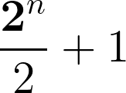

Classical Solution
Worst case operations : moves
Complexity :
Exponential in the input bit size
Notes:
So this is gonna be our worst case operations and pertaining to that we define our Big O notation
Highlight that it is exponential in the terms of inputs

Slide 13
The Deutsch Jozsa Algorithm
Formulate the function as a Quantum Oracle
Solve problem in a single try by using the superposition and interference properties of qubits
Notes:
Now comes the quantum algorithm
We will see what is it , what is special in it and how do quantum properties help in providing us a speedup over the naive classical algorithm

Slide 14
Quantum Solution - Oracles?
We said to formulate our function as an oracle. What is it?
An oracle is a black box - it will give you an answer depending on the input you give to it
Ultimately, an oracle is just a quantum gate
Oracles are used in almost all quantum algorithms and even in the Grover’s algorithm!
What does it look like for the Deutsch Jozsa algo?
Notes:
So the first thing is an Oracle
Simply, it is just another quantum gate
Like our classical function f(x), think of it as the quantum analogue of this function, encoded into quantum gates
Oracles are used in many algorithms, such as the Bernstein Vazirani algorithm, Grovers, and DJ to name a few

Slide 15
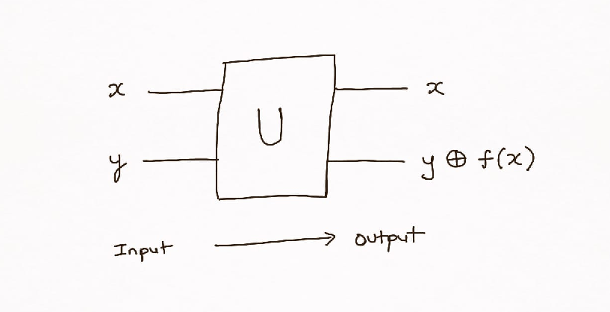

Quantum Solution - The Oracle
REVERSIBLE
Where’s the speed up?
Notes:
For the DJ algo , it like this -
Given an input and an output bit, we XOR the output bit with the value of F(x) over it
Note that any quantum operation needs to be unitary or self inverting, so we need our oracle to be reversible
And it is !

Slide 16
Quantum Speed-up
Superposition Oracle Interference
All possible inputs passed All inputs processed at once Opposite input phases cancel out simultaneously
Notes:
We have 3 components of the algorithm which would provide the speedup which we are looking for
Explain the slide

Slide 17


Quantum Solution - The algorithm
Initiate a quantum circuit with an n-qubit input register, x, plus 1 extra qubit, y
Put the y qubit into the state
Apply Hadamard gates (H) to all the qubits of x - Superposition
Apply the oracle once to x and y
Apply the H gates back to x and y - Interference
Measure the probability of the state on the x register
If it is 0, the function is balanced
If it non - zero, it is constant

Slide 18
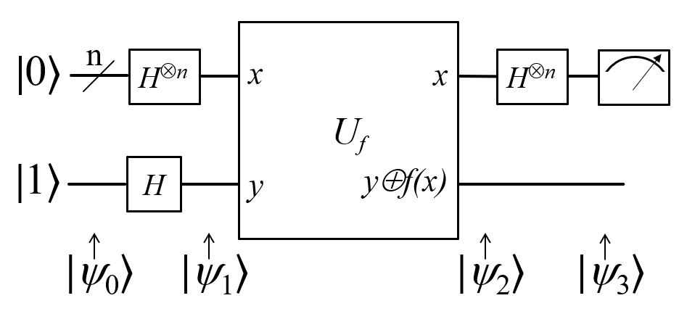
Input Qubit Register
Extra Qubit
Oracle
Now the details

Slide 19
Mathematics
Essential to see how quantum works and how it is different
Notes:
We need to understand the mathematics of this algorithm to really get the

Slide 20


State

Slide 21


State

Slide 22
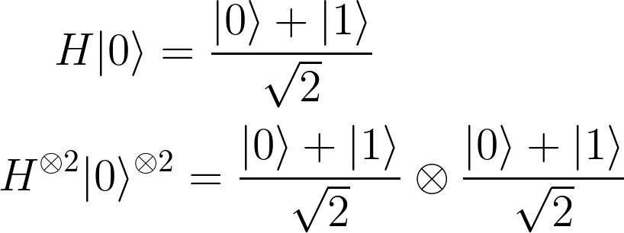
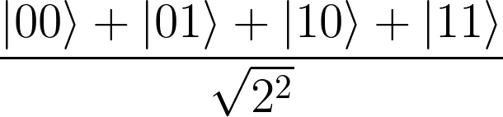
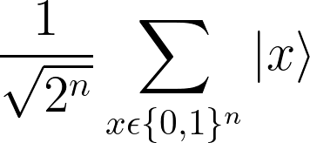
…
Notes:
Explain the set notation more - cartesian product of sets

Slide 23
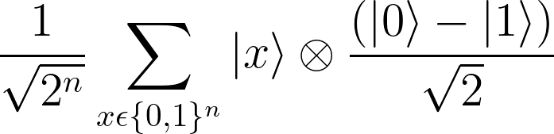
State
Notes:
Say that the state which we just built up, that’s what is present on this slide

Slide 24

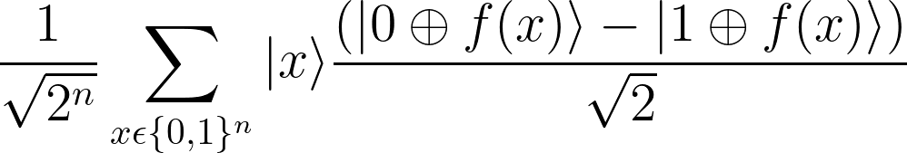
State
Notes:
Now we are going to apply our oracle and see the state for the quantum system
Let’s explain the application of the oracle a bit now

Slide 25


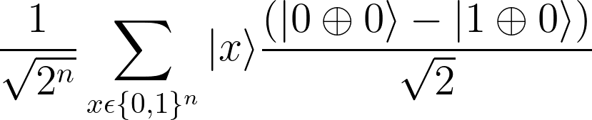
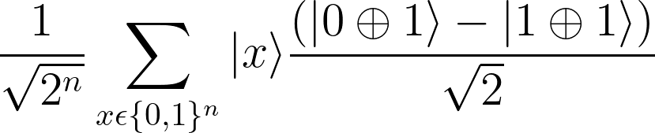
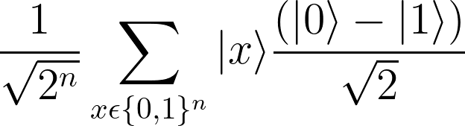
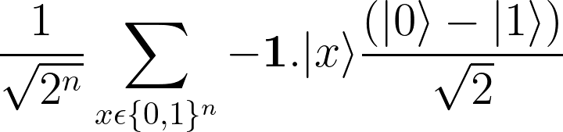
Expanding over the function inputs we can either have :
Notes:
We are only going to have 2 cases -
Either for the input x, f(x) is 0
Or, for x, f(x) is 1
Let’s see the case for 0 first
explain
Now this is the case for 1

Slide 26
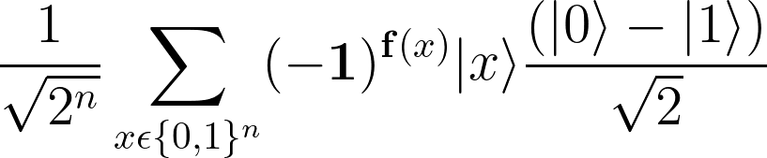
State
Notes:
Explain the -1 ^f(x) formula
f(x) = 0 -> then |-> state
else, -|-> state

Slide 27

State
Let us build this state !
Notes:
This is the final part of our algorithm
So let us build the state together!

Slide 28


Steps
We can lose the extra qubit as its work is done
Apply the hadamard transform on a general input
Here, x is an n - bit binary input
Example - for n = 4, x can range from 0000 -> 1111
We saw how we apply the to the all zero state
GENERALIZE?
Notes:
There are 2 aspects -
The extra qubit does not have any work for us now, we can drop that
Now, we wanna use interference, that means we need some kinds of superposition element in our circuit
For that, we apply the Hadamard gate again on our input register.
But let’s just go step by step

Slide 29
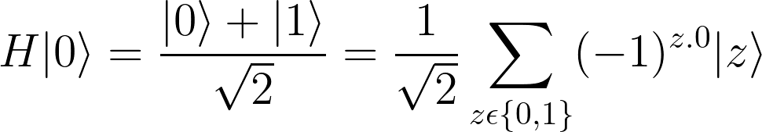
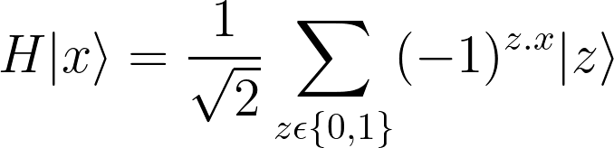
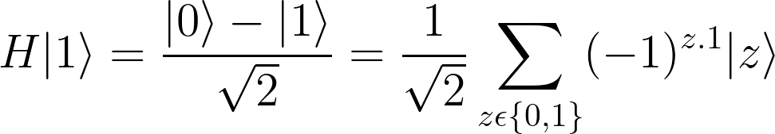
Steps
How does H gate act on single qubits?
Notes:
This is how we can formulate the single qubit Hadamard transform
If you carefully see, the |+> state
z is 0, -1 is gonna become 1
z is 1, then too with 0 its 1
So we have the + state here
Next, we can also extend this to the |1> state

Slide 30
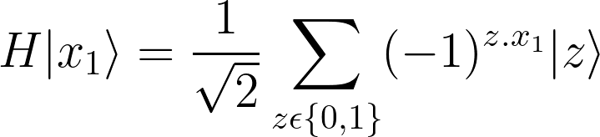

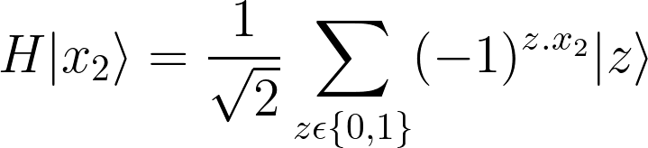
Steps
Now, a general binary input is :
Each element is 1 - bit
How to combine for n bits?
…
Just combine the left expression using tensor products!
Notes:
x_i is ONE BIT of the general binary input

Slide 31



Example
We need the term i.e. -
Notes:
This is an example which highlights what we want to do here
Explain more

Slide 32

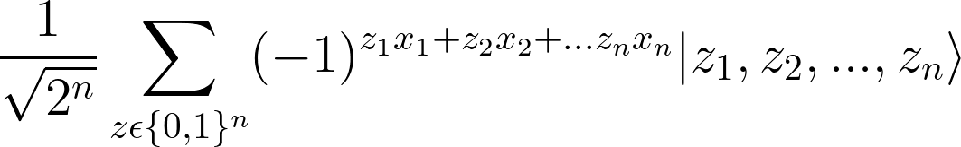
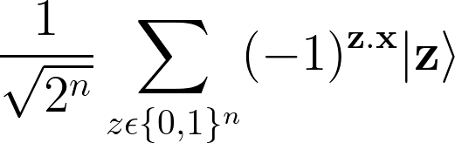
Final Term
We need the term
Dot Product!
mod 2
Notes:
Here, if you try to derive the combination of ALL the bits of the input, you’ll arrive at this

Slide 33
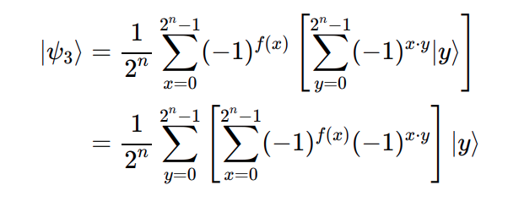
State
Notes:
This may be a lot but take it one step at a time
The next line just shows the rearrangement of the sums nothing much

Slide 34
We’re through!
That was some patience which you guys showed.
Now we are ready to reap the results!
Notes:
Now we’ll understand how we have the speedup
We just queried the oracle once right , and we’ll see how we can get the result in just measuring the input register

Slide 35

Measurement
Now, we will measure the first register for the state
How do we do that?
Taking the inner product or the square of the absolute value of its amplitude
Putting y = |00…0> we get this term

Slide 36
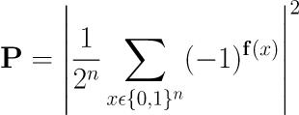
Measurement
Now, we just calculate the probability by taking its absolute value and squaring it
CONSTANT, P = 1
BALANCED, P = 0
Either 0 or 1
Numerator and Denominator cancel out to 1
Half 0 and Half 1
Numerator has + and - terms
cancel out to 0

Slide 37

Quantum Solution
Worst case operations : 1 move
Complexity :
Exponential in the input bit size

